Slide 1


Virtual Reality for Teleoperation in Manufacturing
Presented by: Cecilia Aponte (1822225)
Paper: ‘Baxter’s Homunculus: Virtual Reality Spaces for Teleoperation in Manufacturing’
Authors: Jeffrey I. Lipton, Aidan J. Fay, and Daniela Rus

Slide 2
Overall Goal
“ Humans could supervise robots from a distance and connect seamlessly to a robot to command it to do a task, teach a new task, or help it recover from a failure.”
→ Decouple physicality from manufacturing tasks with VR
Virtual Reality for Teleoperation in Manufacturing
Aponte, Cecilia (1822225)

Slide 3
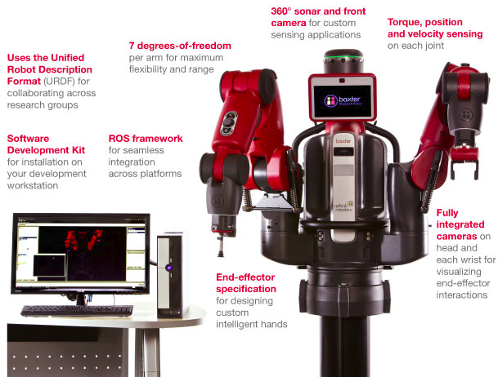
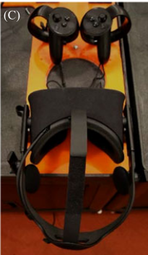
Concept of the System
Telerobotic system that uses VR technology and existing control infrastructure
Performs manufacturing tasks (pick & place, assembly, etc.)
Devices used: Baxter robot, Oculus Rift with Touch controllers
Virtual Reality for Teleoperation in Manufacturing
Aponte, Cecilia (1822225)

Slide 4
Network Capabilities
Can run in multiple networks
Inter-network operation are possible by changing the channels the program subscribes to without changing network configurations
Testing of system was done in:
Wired local network
Wireless connection in same building
Wireless connections in different cities
Frame rate on hand cameras and range updates were reduced due to speed of connection
Virtual Reality for Teleoperation in Manufacturing
Aponte, Cecilia (1822225)

Slide 5
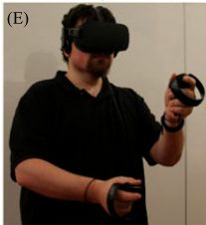
Concept of the System
Control room contains multiple sensor displays and dynamic mappings to select the engagement between user and robot
User study showed that new users were faster and more accurate than automation or direct telepresence systems
Virtual Reality for Teleoperation in Manufacturing
Aponte, Cecilia (1822225)

Slide 6
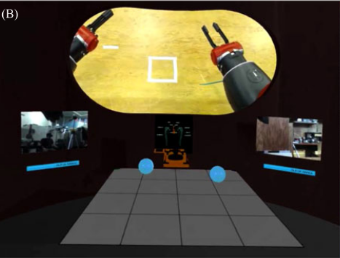
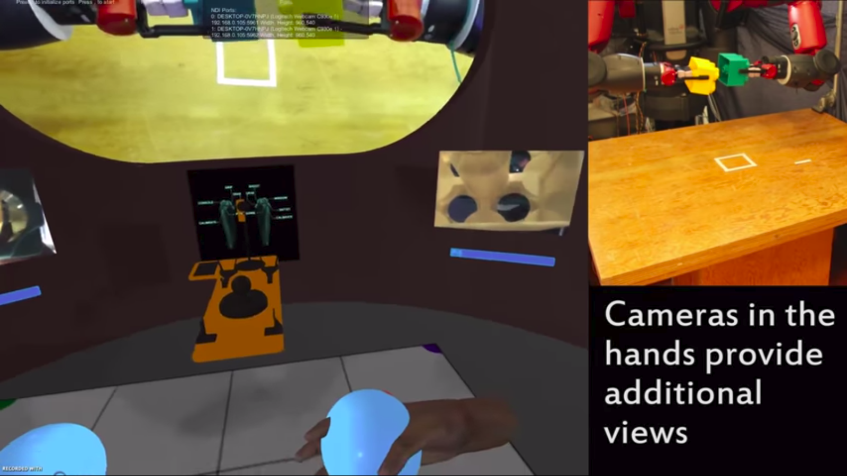
Background
Not necessary to connect the
states of the user and robot
User is embedded in the same point of view of the robot by connecting to the Virtual Reality Control Room (VRCR)
User’s state is mapped to the VRCR
VRCR is mapped to the robot
Removes the need of sensory stimuli to the user from the robot
Virtual Reality for Teleoperation in Manufacturing
Aponte, Cecilia (1822225)

Slide 7
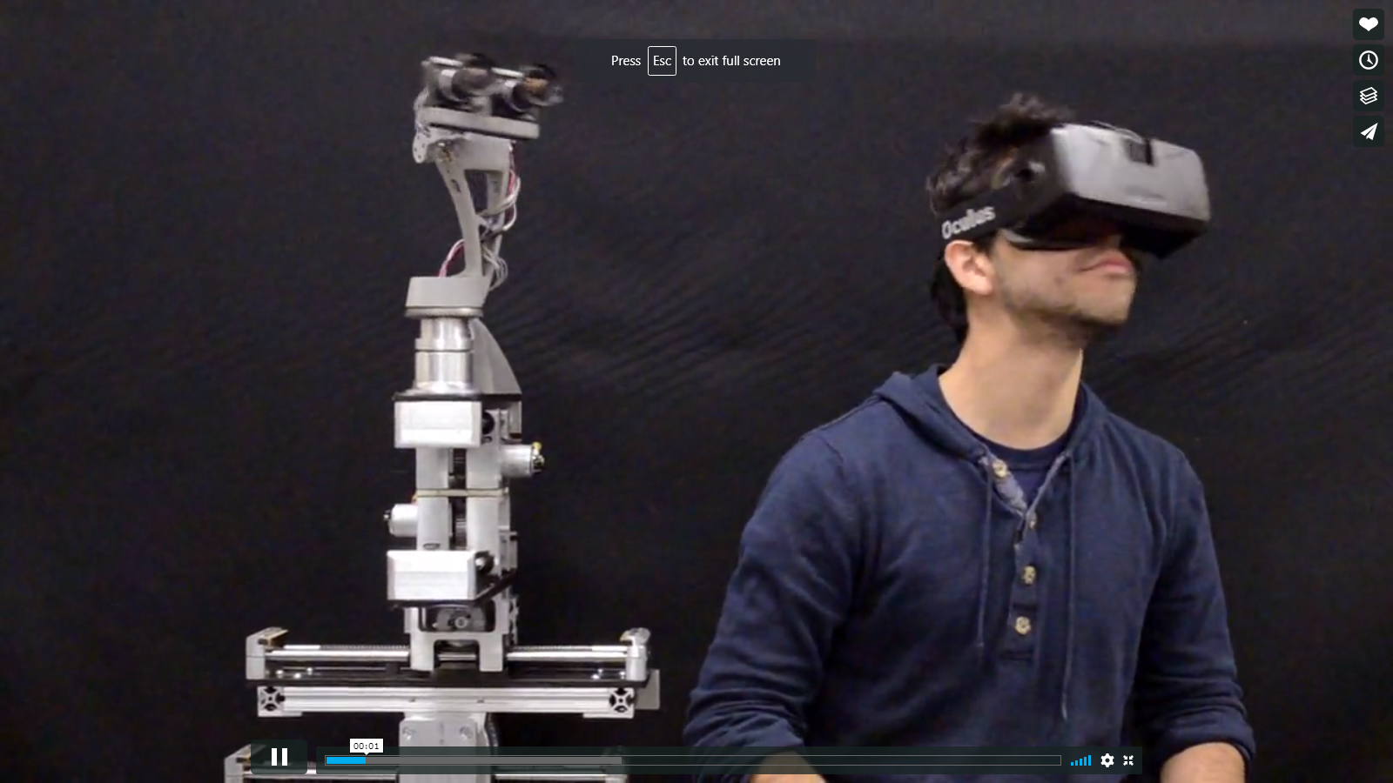
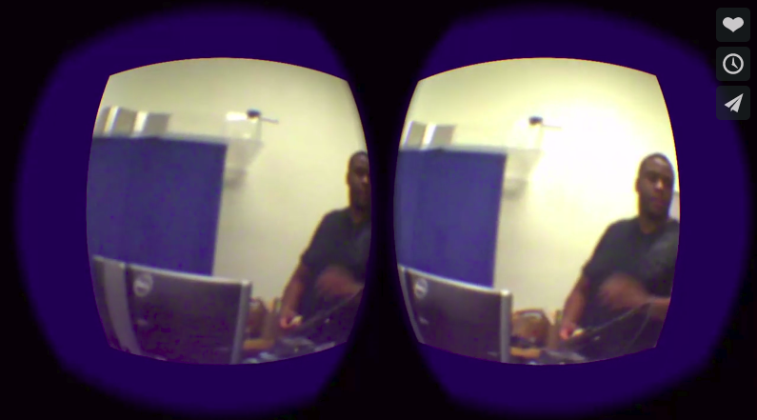
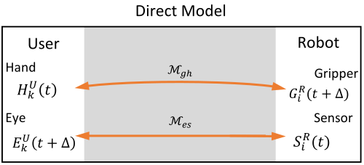
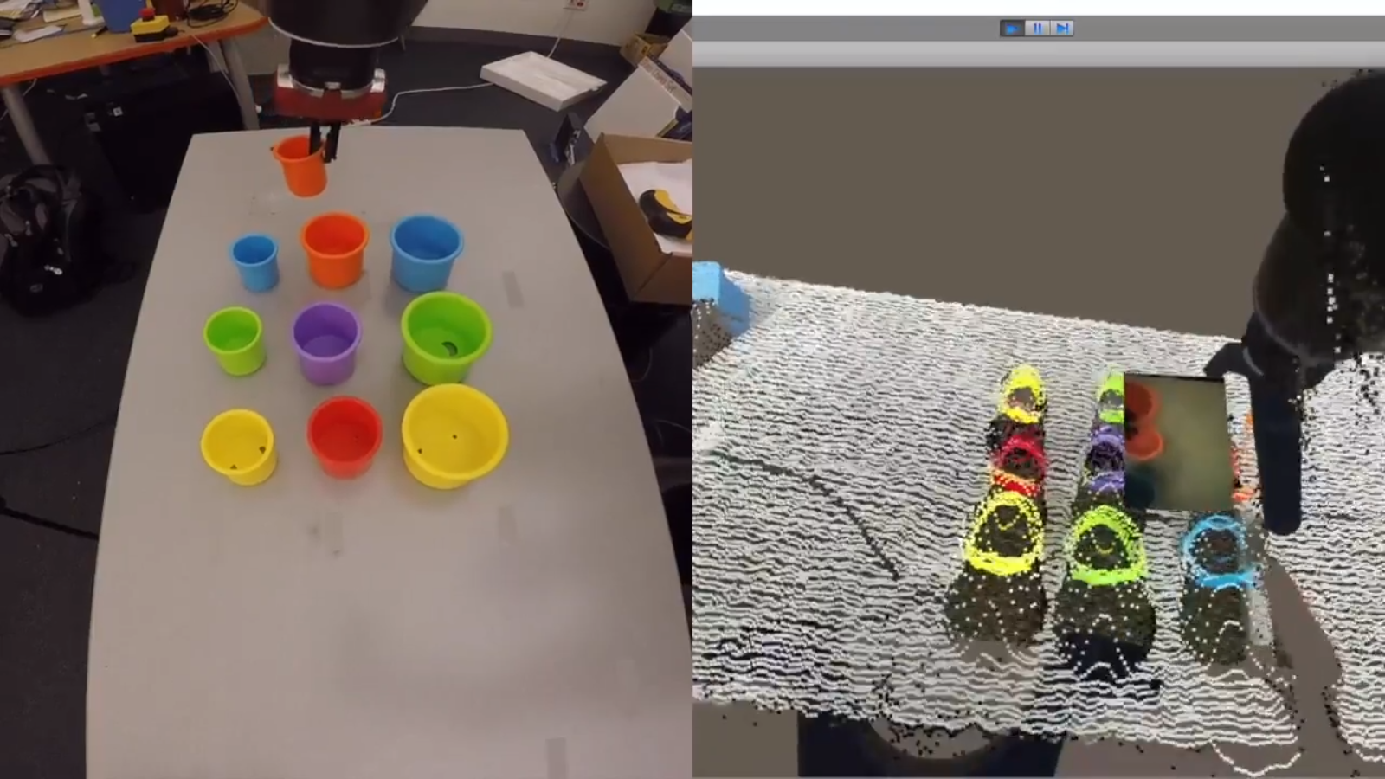
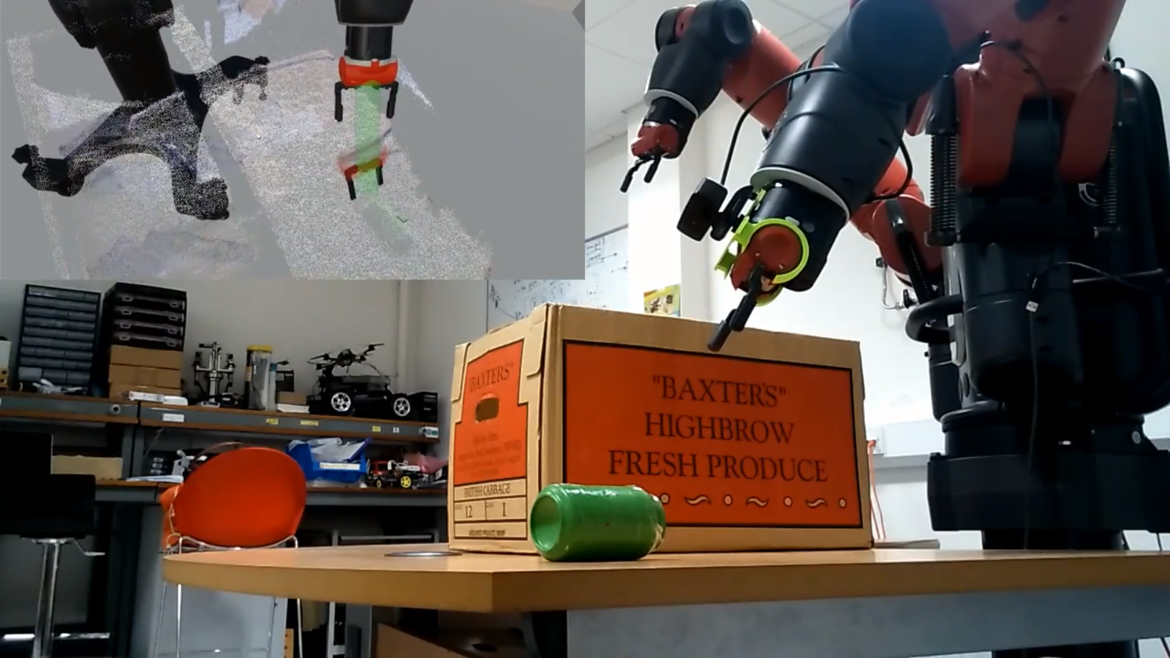
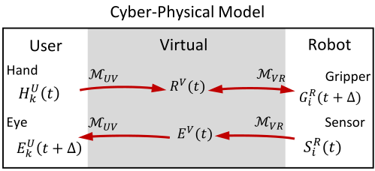
Mappings
Are an object’s state: information that describes it (e.g. position, orientation, sensor values)
These can be transmitted through a mapping:
Directly to the robot
Cyber-Physical System (CPS)
Video link
Video link
Video link
Virtual Reality for Teleoperation in Manufacturing
Aponte, Cecilia (1822225)

Slide 8
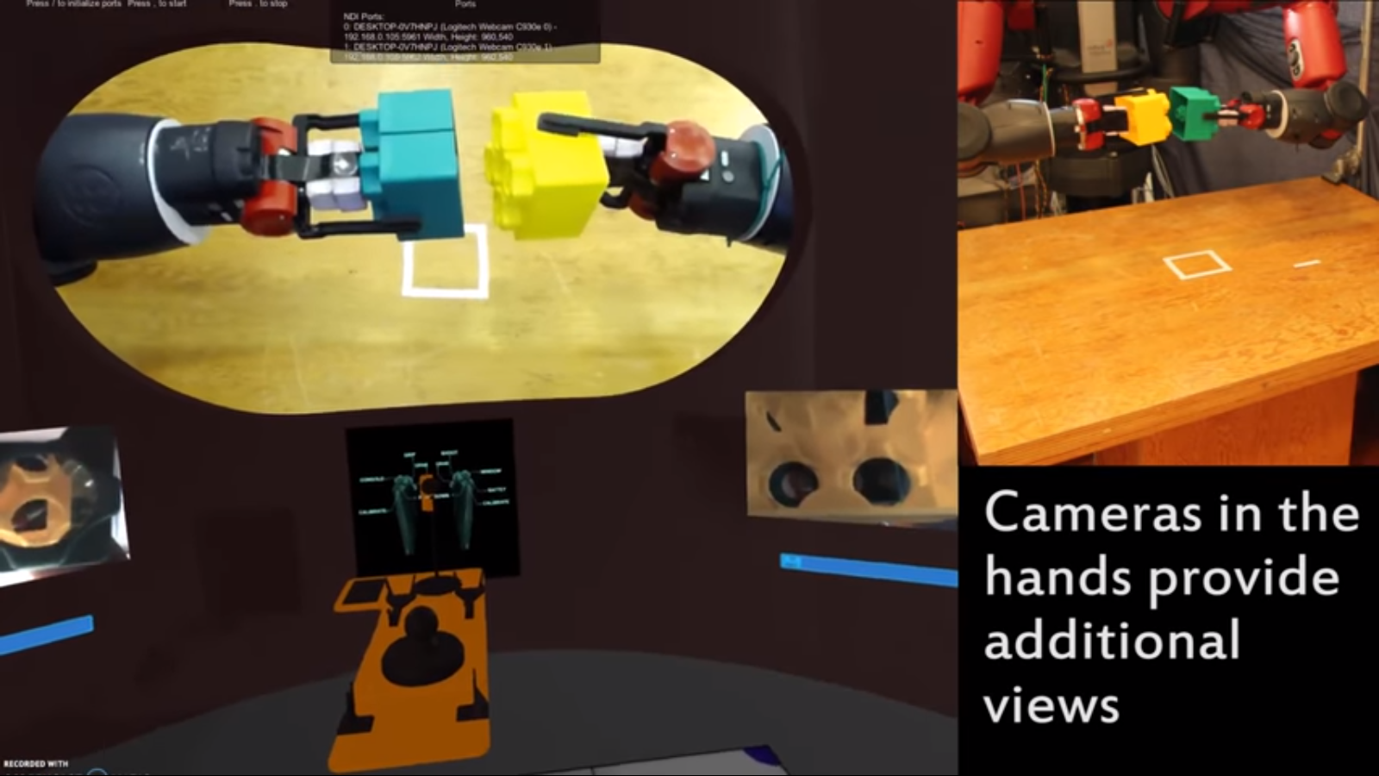
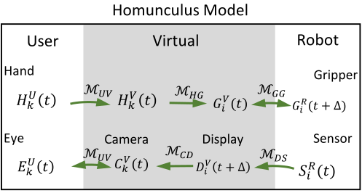
Homunculus Model Mappings
Mappings are mediated in the VRCR using:
Displays and objects in the space
Map: user space → virtual space → robot space
Robot environment mapped from 3D to 2D
Forward cameras collect actual view in small area
Brain then infers the 3D representation of each
Sensors are cleanly displayed in VRCR
Video link
Virtual Reality for Teleoperation in Manufacturing
Aponte, Cecilia (1822225)

Slide 9
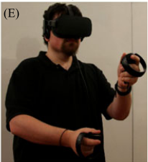
Details on Architecture
Head movements are compensated regardless of the sensor update rates, since virtual camera updates are rendered in a separate loop
Delays in rendering are compensated since commercial VR game engines already solve for this (e.g. Asynchronous Timewarp)
Therefore delay is negligible since vision queues are generated from the VRCR not camera
Virtual Reality for Teleoperation in Manufacturing
Aponte, Cecilia (1822225)

Slide 10
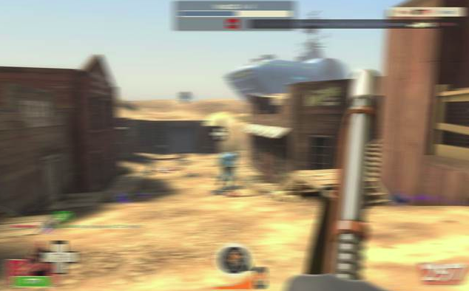
Note: Controlling for Delays
Delays are common when communicating data between objects, one solution for delay in rendering is the Asynchronous Timewarp created by Oculus
Technique to compensate for dropped frames
Shifts the rendered image slightly before sending it to the display to adjust for changes in head movement that occurred after the scene was rendered and thereby reduce the perceived latency
Does so by generating intermediate
frames in situations when a game
can’t maintain frame rate
Virtual Reality for Teleoperation in Manufacturing
Aponte, Cecilia (1822225)

Slide 11
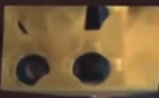
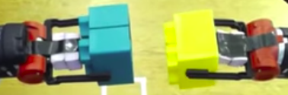
Details on Architecture (cont.)
Mapping options: position & orientation, position & single angle, and position only
These are picked by the grasp and finger location sensed by the touch controllers
When user releases control of gripper, system uses motion planning solver to find the joint states
Can use relative distance between current location marker and their hand to plan for movement
Shift body or use the other camera to increase focus during task
Virtual Reality for Teleoperation in Manufacturing
Aponte, Cecilia (1822225)

Slide 12
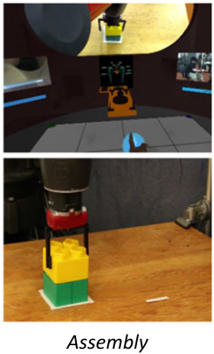
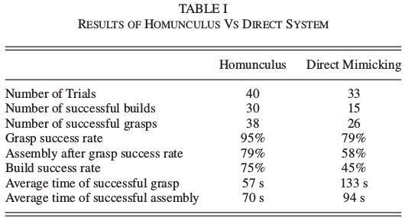
Results
User study conducted with homunculus and direct systems
Users trained; no previous VR or teleoperation experience
Failure: unrecoverable error, miss-alignment, longer than 6 minutes
Assembly task: grab random block → stack on top another block
Result of using homunculus:
Improves performance on
grasping and assembling
Makes users faster at grasping
objects from table
Virtual Reality for Teleoperation in Manufacturing
Aponte, Cecilia (1822225)

Slide 13
Analysis of Results
Improvements likely due to:
use of hand cameras
ability to vary user perspective to focus on a task
Assembly speed difference is less significant probably since cameras are not available once objects are grasped
Higher success rate for assembly tasks compared to direct and vision-based algorithms (100% successful in grasping)
Virtual Reality for Teleoperation in Manufacturing
Aponte, Cecilia (1822225)

Slide 14
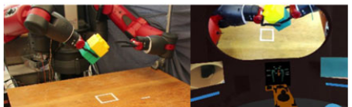
Other Tests: Fixture-less Assembly
Uses two mappings:
Rotation information is fixed during grasping
Rotation of user hands are mapped to robot during assembly in free-space
Virtual Reality for Teleoperation in Manufacturing
Aponte, Cecilia (1822225)

Slide 15
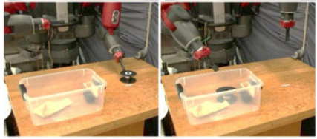
Other Tests: Pick-n-Place
Testing system’s ability to handle objects of different shape and compliance
User can quickly execute since it has intuition of object’s response to stimuli
Virtual Reality for Teleoperation in Manufacturing
Aponte, Cecilia (1822225)

Slide 16
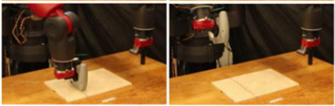
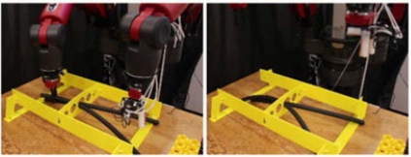
Other Tests: Manufacturing Tasks
Tested the relative utility of the hand cameras since camera on the gripper holding the staple gun can’t be used
Improvement: addition of pressure sensor and display
Virtual Reality for Teleoperation in Manufacturing
Aponte, Cecilia (1822225)

Slide 17
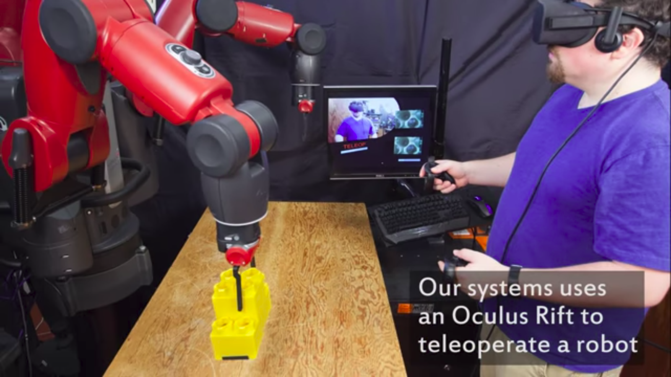
Summary
Flexible system across tasks, networks, and bandwidth
Utility and ergonomics are improved due to the system’s ability to change between mappings
Low-cost implementation using off-the-shelf robot and VR hardware and software, enabling easier deployment
Virtual Reality for Teleoperation in Manufacturing
Aponte, Cecilia (1822225)

